Slide 1
Cyber Security
CANASA

Slide 2
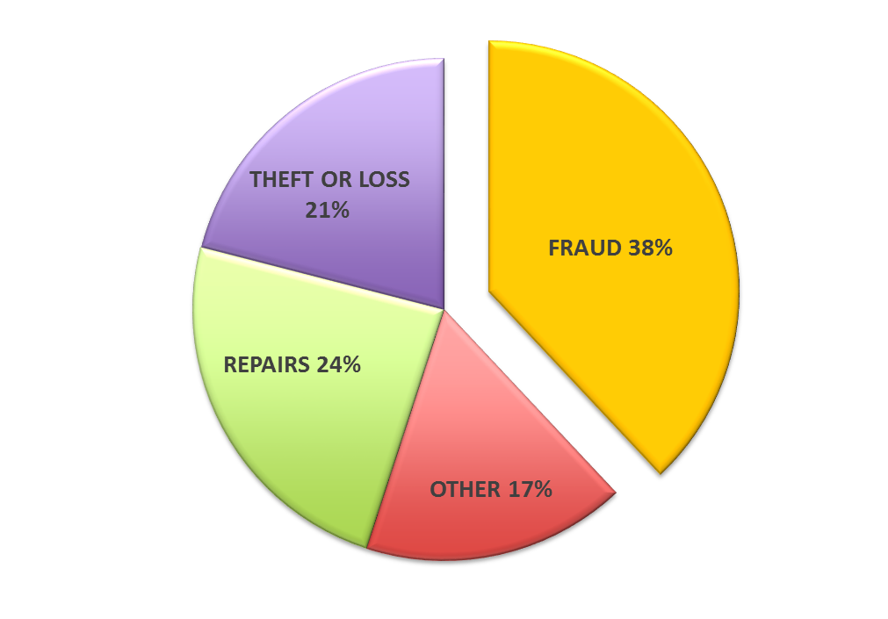
The Global Price Tag Of Cyber Crime
450 BN
$
(Going to be $1T by 2019)

Slide 3
62
% increase in breaches for small business
88
% insider data breaches due to abuse
91
% increase in targeted attacks
14
% of employees that will sell their
credentials for $150 or less!

Slide 4
Ransomware
Ransomware sales on the dark web market rocketed from $250,000 to over $6M in the last year
$301 M was paid to ransomware hackers last year
210 days. The average time a hacker is in a system before being found

Slide 5
E-mail Phishing
UPS
Wire Transfer e-mails
Netflix

Slide 6
Open and Free WiFi
Do you allow employees to connect to free or open WiFi hotspots
Have you heard of
Do you have a VPN for your employees to connect to the office for e-mails?

Slide 7
White Hackers
Average salary for Hacker with no degree $104,000
Average salary for Hacker with degree $120,000

Slide 8
Central Stations Being Hacked
Many Central Stations have been hacked
Some have had their servers used for illegal purchases
Some have had data stolen
Many have had their databases encrypted for ransom

Slide 9
Data Backups
If attacked how long will it take you to run off of backups
Data Backups are critical to protecting yourself from Cyber Attacks
Are your backups vulnerable to Malware?

Slide 10
Cyber Insurance
Cyber Insurance do you have it?
Do you understand what is covered and what is not?
Have you checked with your lawyer about Cyber laws in your area?

Slide 11
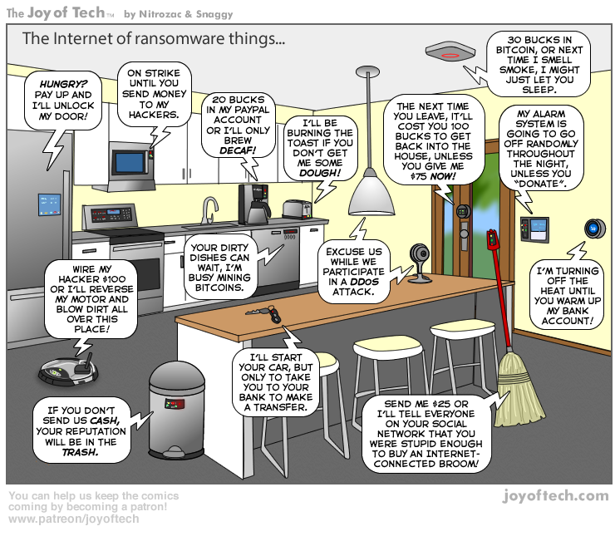

Slide 12
Security Obstacles Facing Business
LACK OF EXPERTISE
LACK OF VISIBILITY
Too much data and not enough intelligence makes visibility into threats challenging. Reactive security infrastructure lacks the timely intelligence needed to identify threats.
We don’t know what we don’t know. Businesses struggle with where to start, how to identify risks, how to prioritize risks and how to reduce the cost of cyber security controls
TARGETED ATTACKS
Attacks are becoming more sophisticated, autonomous and stealthy and are specifically designed to penetrate existing security controls, including security processes and people.

Slide 13
5-Steps to Address Cyber Security
Determine
Business Priorities
Find Gaps
& Risks
Measure Security
Maturity
Risk Management
Program
Operationalize
& Optimize
Cyber-6
Discovery
Baseline
Prioritize
Respond

Slide 14
Cyber Security Is A Business Issue
Cyber Security is a Business Issue not just an IT Issue
A Talented, Knowledgeable and well supported staff is the best defense
This is not something you can do on your own
The cost to have a company support you is cheaper then the salary of an IT person

